Slide 1
Introduction to Probability and Statistics
4CM521
Sets, Events and Probability

Slide 2
Objectives
Definitions and notation
Conditional Probability
Multiplication Law
Law of Total Probabilities
Bayes’ Theorem

Slide 3
Uncertainty in statistics
Is there anything you can say for certainty?
Are you able to say for certain how long this lecture is?
What will be the weather tomorrow?
The list is endless…

Slide 4
Chance of outcomes
Statisticians use the word experiment to describe any process that generates a set of data
Recording of information (whether numerical or categorical) are referred to as observations

Slide 5
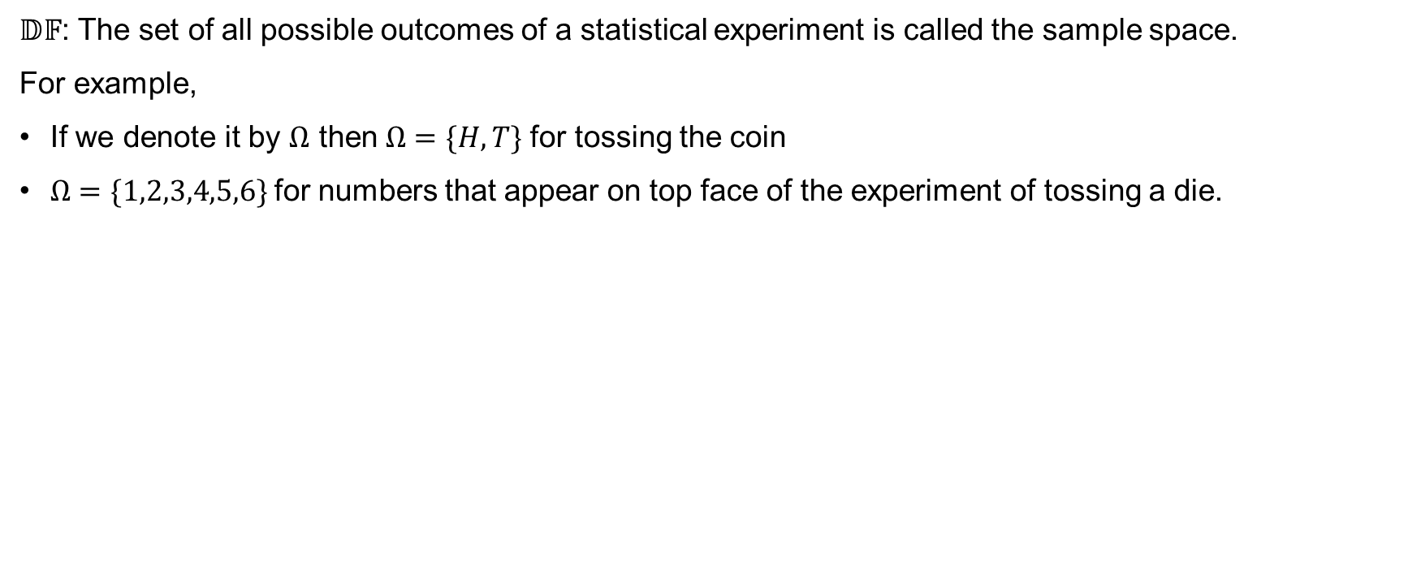
Sample space
$𝔻𝔽$: The set of all possible outcomes of a statistical experiment is called the sample space.
For example,
If we denote it by $Ω$ then $Ω=\{H,T\}$for tossing the coin
$Ω=\{1,2,3,4,5,6\}$for numbers that appear on top face of the experiment of tossing a die.

Slide 6
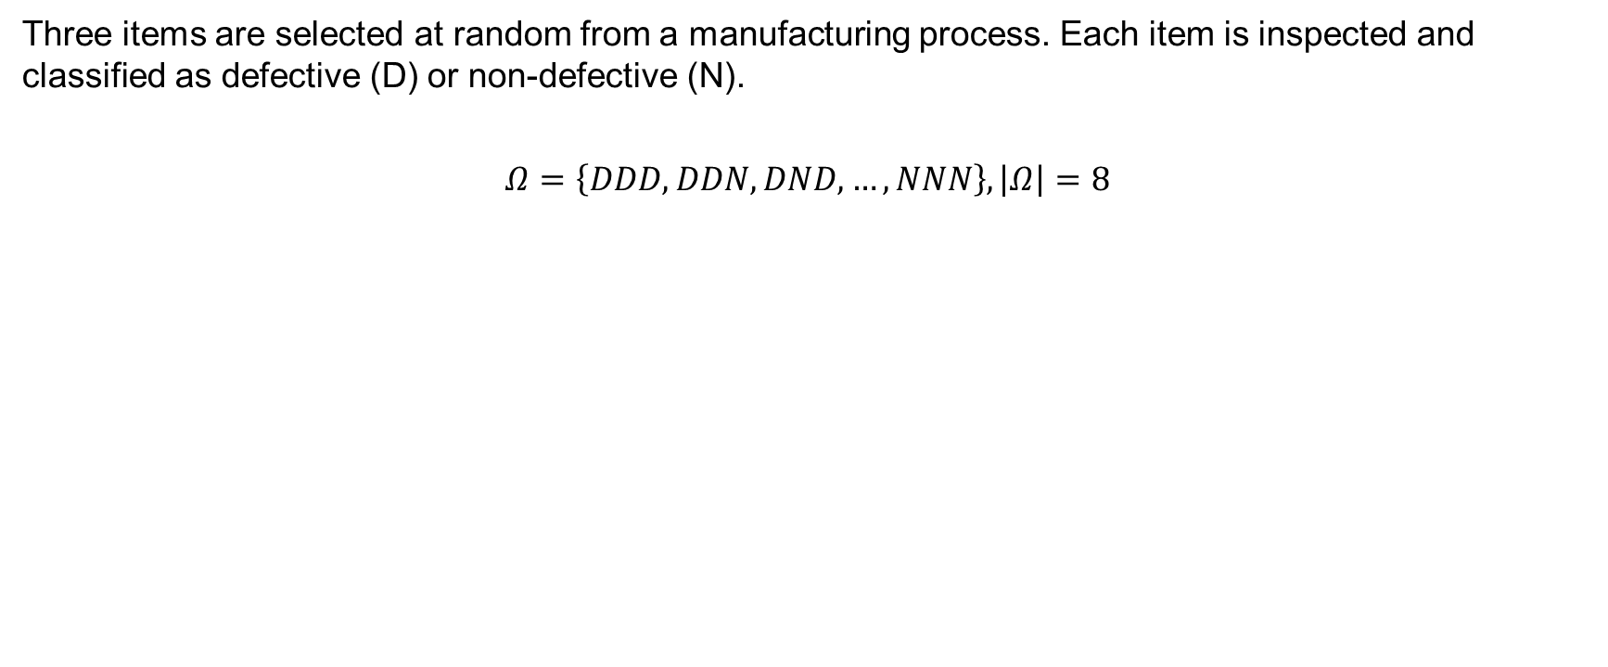
Example 5.1
Three items are selected at random from a manufacturing process. Each item is inspected and classified as defective (D) or non-defective (N).
$$Ω=\left\{DDD, DDN, DND, …, NNN\right\}, \left|Ω\right|=8$$

Slide 7
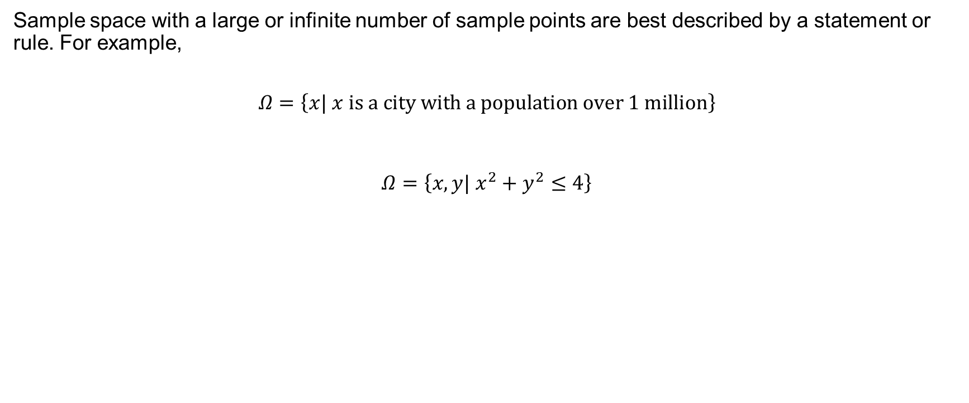
Sample space (continued)
Sample space with a large or infinite number of sample points are best described by a statement or rule. For example,
$$Ω=\left\{x| x is a city with a population over 1 million\right\}$$
$$Ω=\left\{x,y| x^{2}+y^{2}≤4\right\}$$

Slide 8
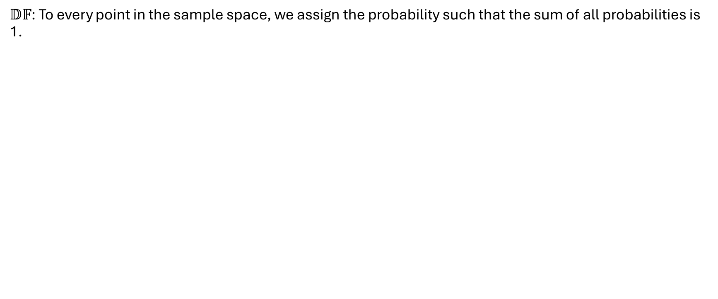
Sum of probabilities
$𝔻𝔽$: To every point in the sample space, we assign the probability such that the sum of all probabilities is 1.

Slide 9
Dice Example
$$X$$ | $$1$$ | $$2$$ | $$3$$ | $$4$$ | $$5$$ | $$6$$
Probability | $$1/6$$ | $$1/6$$ | $$1/6$$ | $$1/6$$ | $$1/6$$ | ?
1/6 + 1/6 + 1/6 + 1/6 + 1/6 + ? = 1
? = 1/6

Slide 10
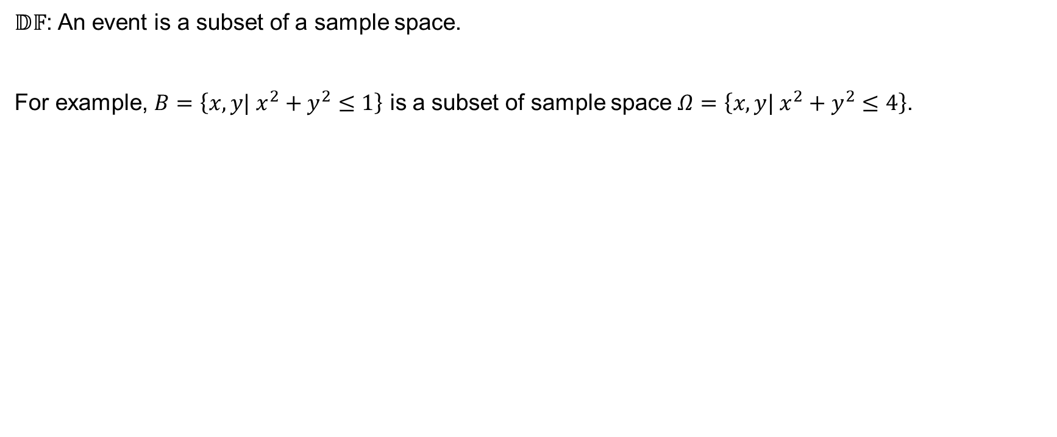
Subsets
$𝔻𝔽$: An event is a subset of a sample space.
For example, $B=\left\{x,y| x^{2}+y^{2}≤1\right\}$ is a subset of sample space $Ω=\left\{x,y| x^{2}+y^{2}≤4\right\}$.

Slide 11
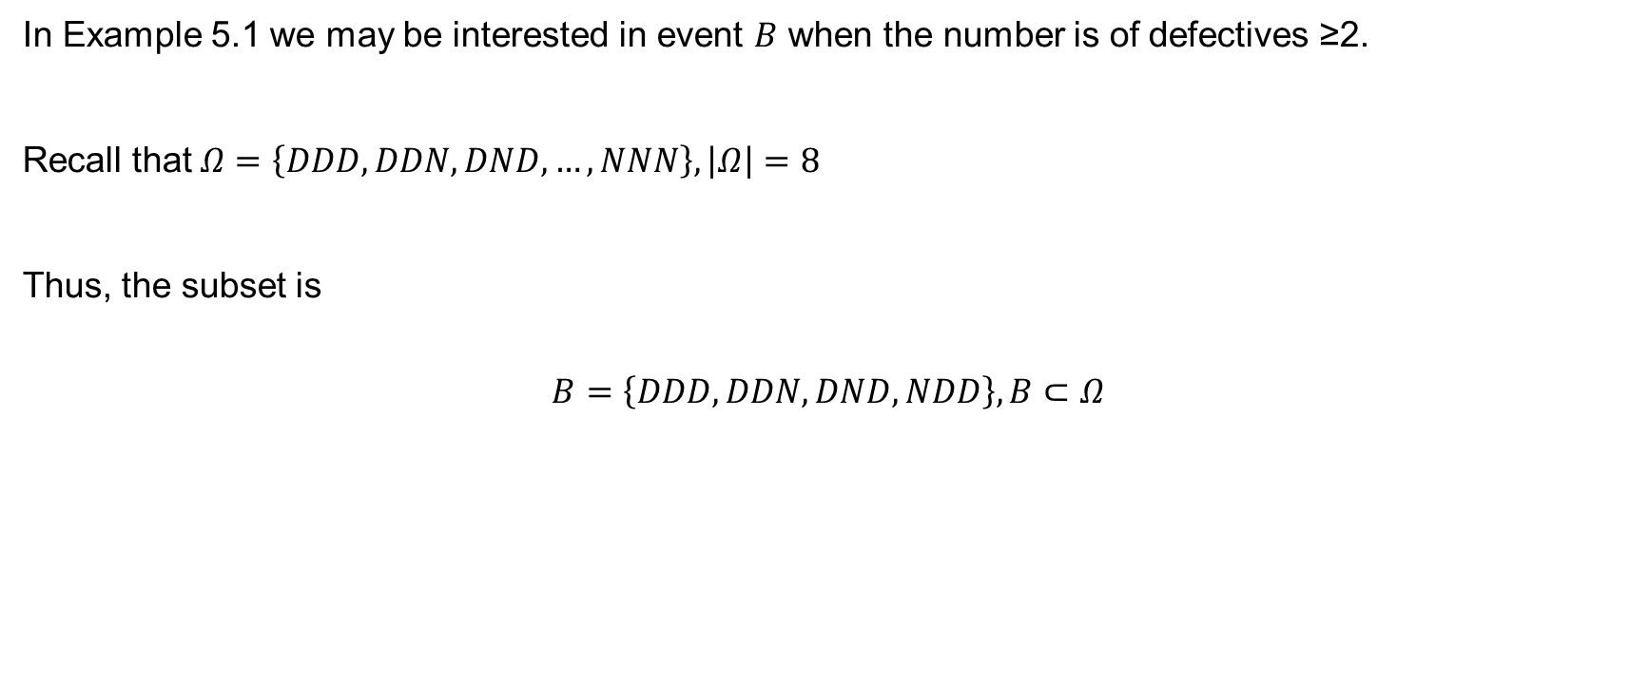
Example 5.1 (continued)
In Example 5.1 we may be interested in event $B$ when the number is of defectives ≥2.
Recall that $Ω=\left\{DDD, DDN, DND, …, NNN\right\}, \left|Ω\right|=8$
Thus, the subset is
$$B=\left\{DDD, DDN, DND, NDD\right\}, B⊂Ω$$

Slide 12
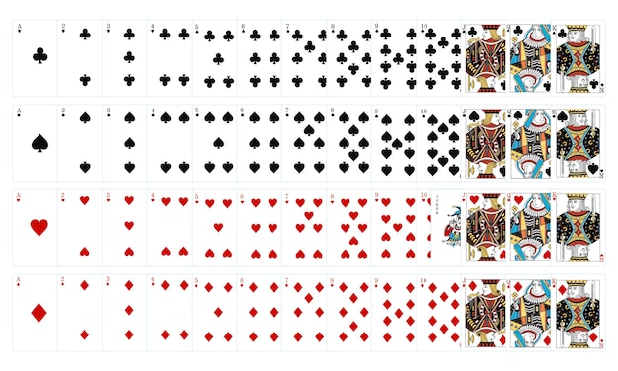
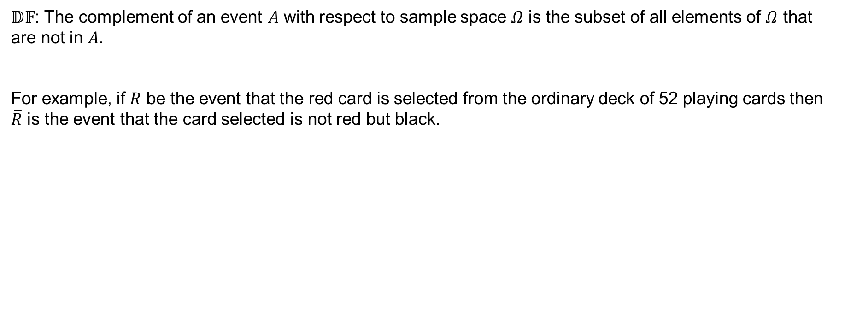
Complement
$𝔻𝔽$: The complement of an event $A$ with respect to sample space $Ω$ is the subset of all elements of $Ω$ that are not in $A$.
For example, if $R$ be the event that the red card is selected from the ordinary deck of 52 playing cards then $\overline{R}$ is the event that the card selected is not red but black.

Slide 13
Set theory
Set theory notation offers a convenient way of explaining certain operations with the events and some of the laws of probability theory.

Slide 14
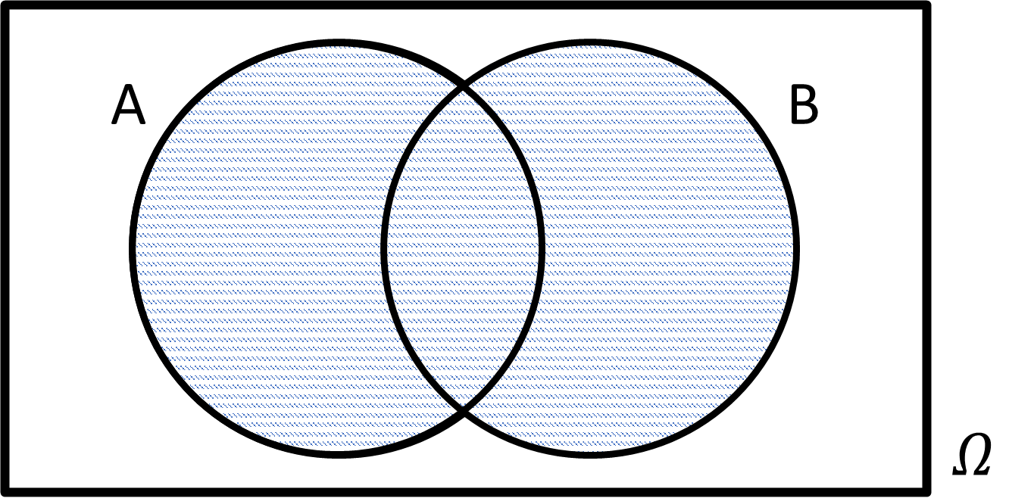
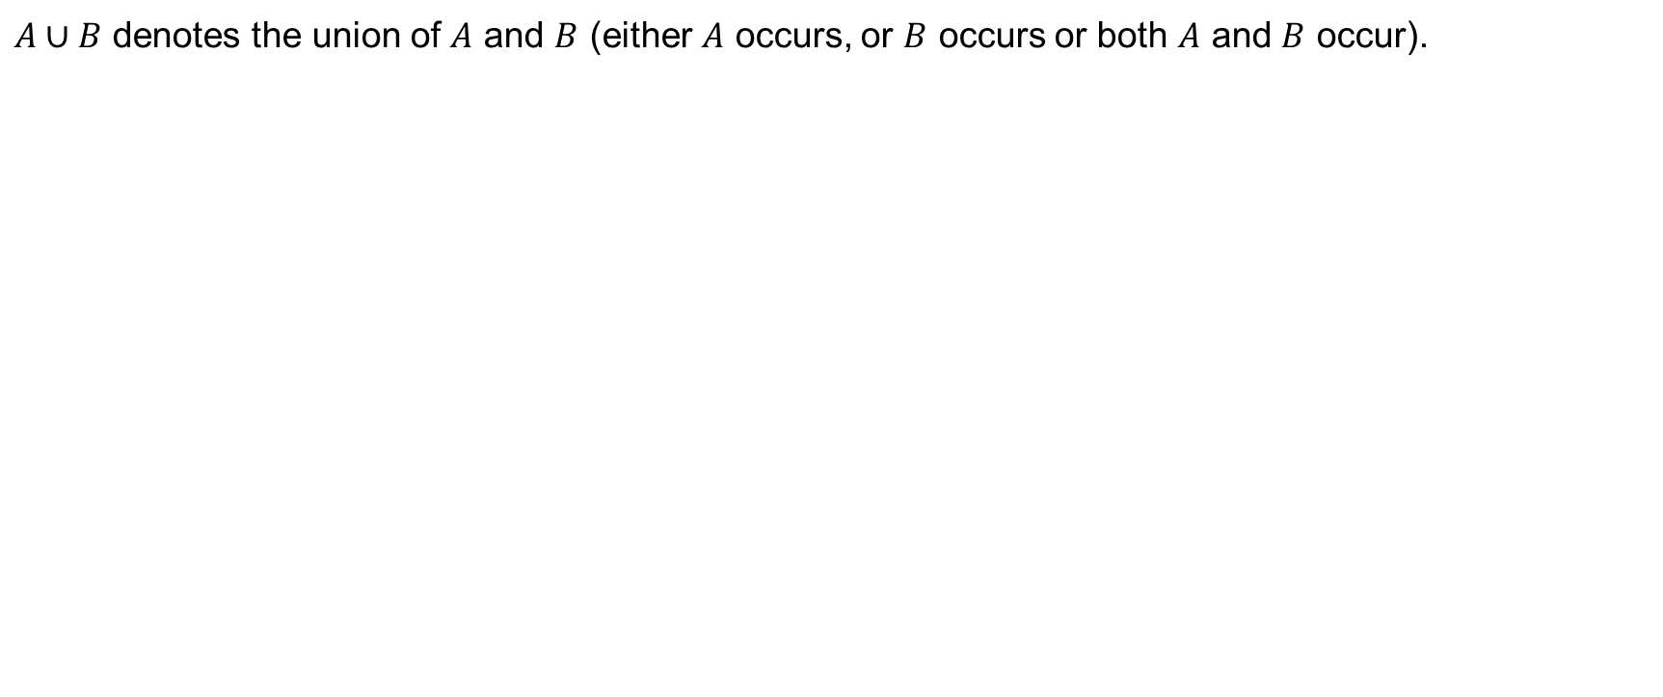
Union
$A∪B$ denotes the union of $A$ and $B$ (either $A$ occurs, or $B$ occurs or both $A$ and $B$ occur).

Slide 15
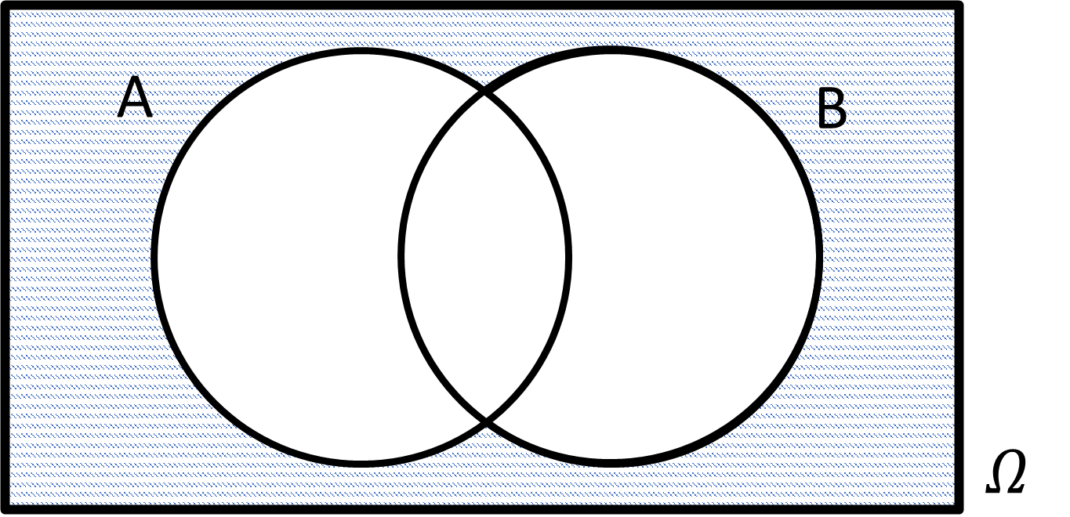
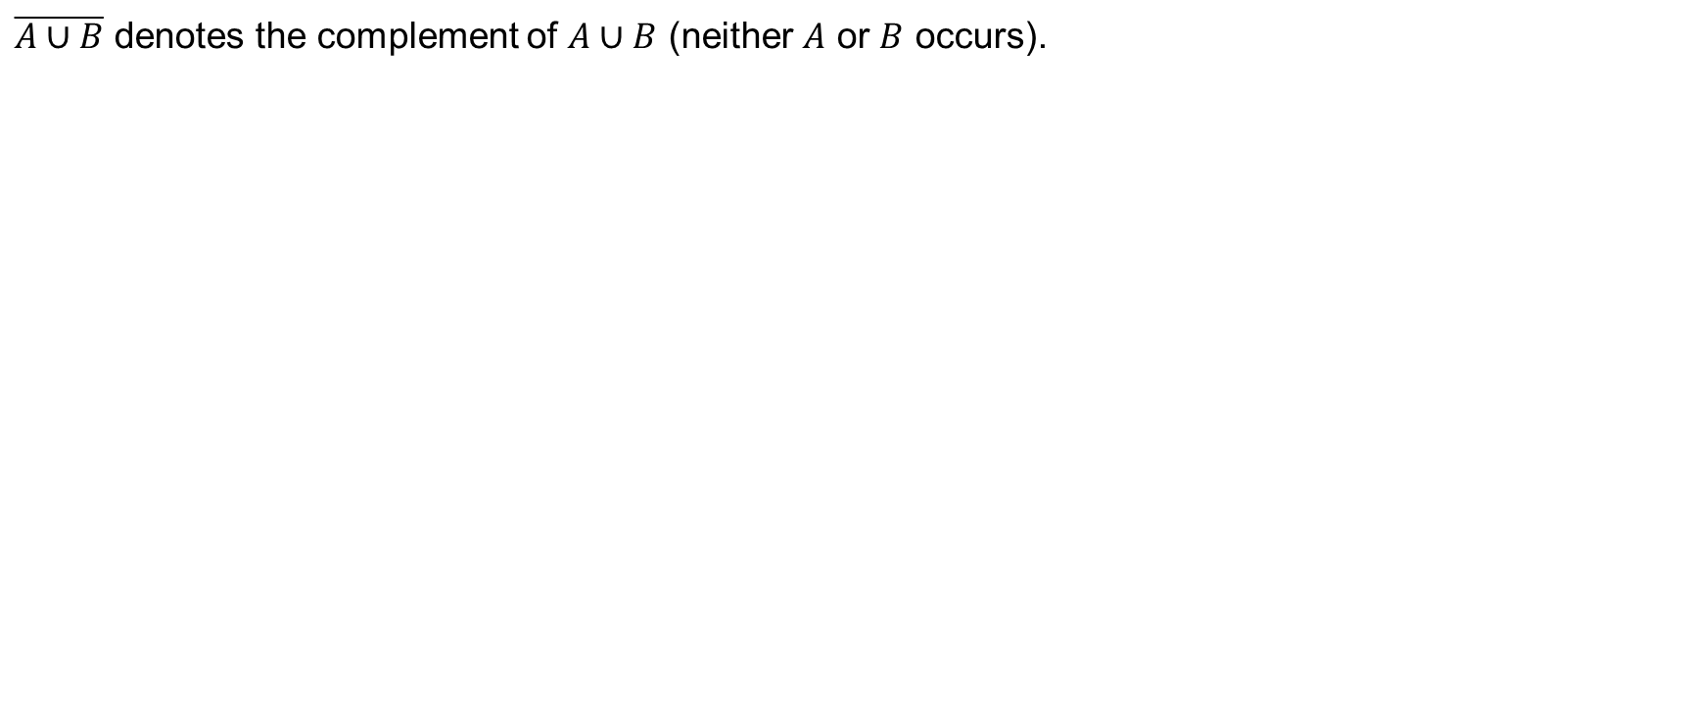
Union (continued)
$\overline{A∪B}$ denotes the complement of $A∪B$ (neither $A$ or $B$ occurs).

Slide 16
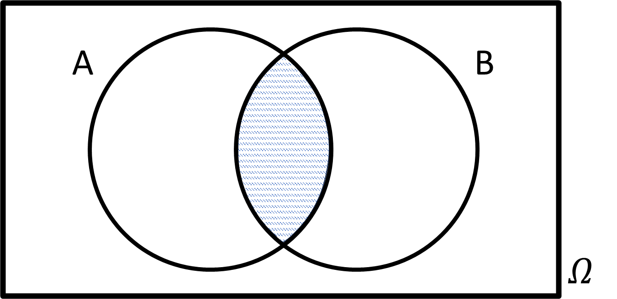
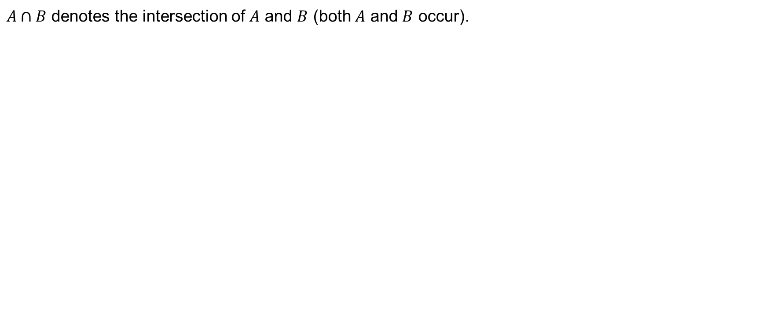
Intersection
$A∩B$ denotes the intersection of $A$ and $B$ (both $A$ and $B$ occur).

Slide 17
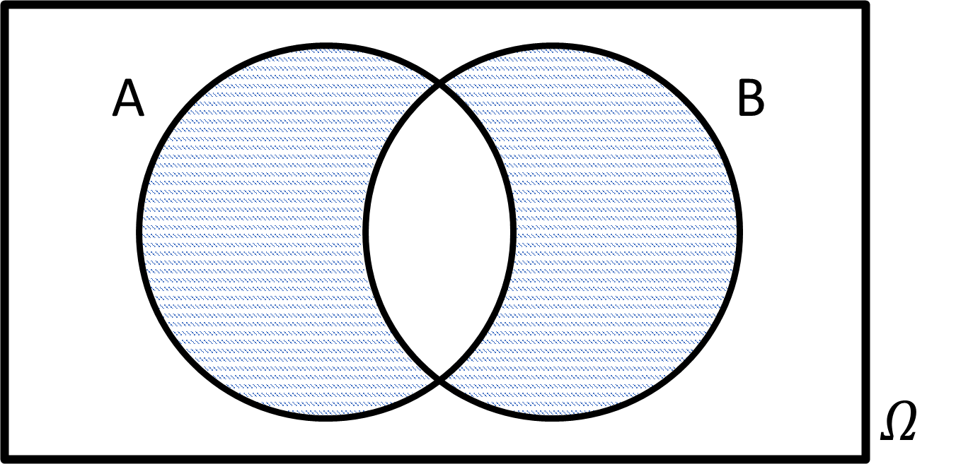
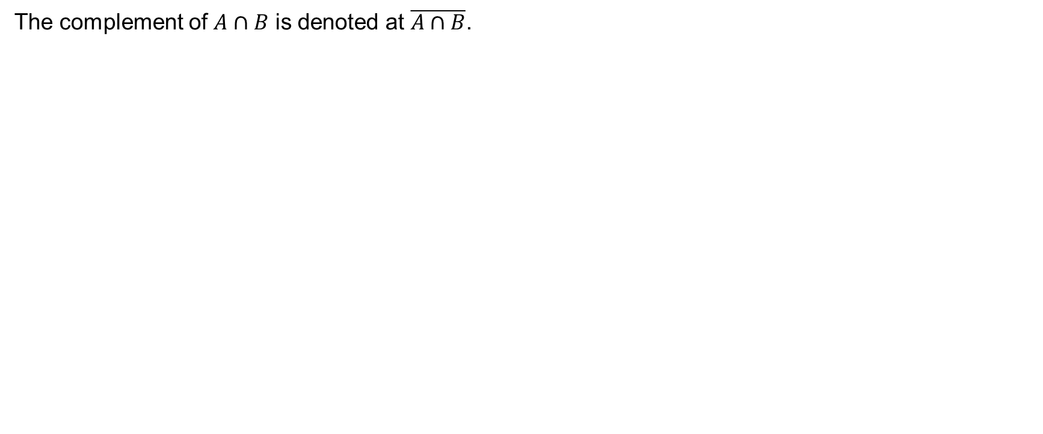
Intersection (continued)
The complement of $A∩B$ is denoted at $\overline{A∩B}$.

Slide 18
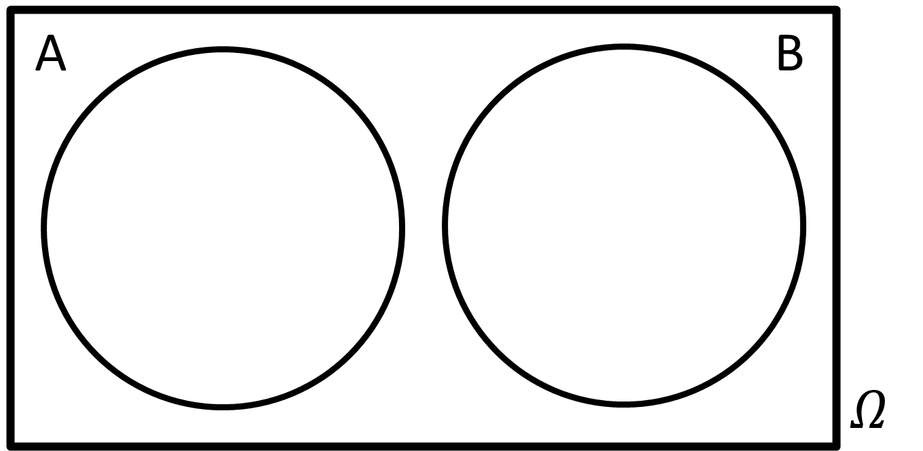
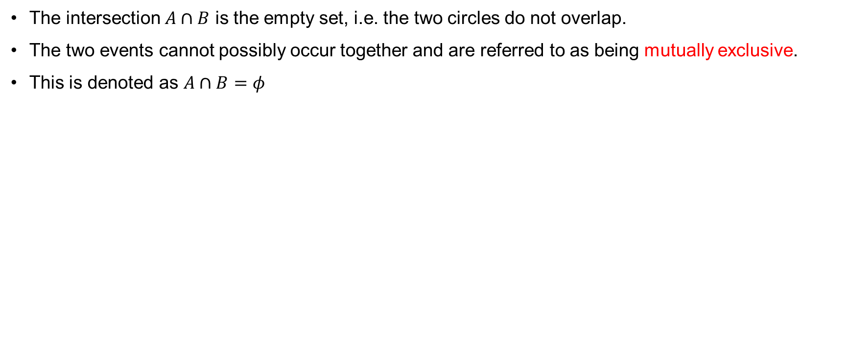
Mutually Exclusive Events
The intersection $A∩B$ is the empty set, i.e. the two circles do not overlap.
The two events cannot possibly occur together and are referred to as being mutually exclusive.
This is denoted as $A∩B=φ$

Slide 19
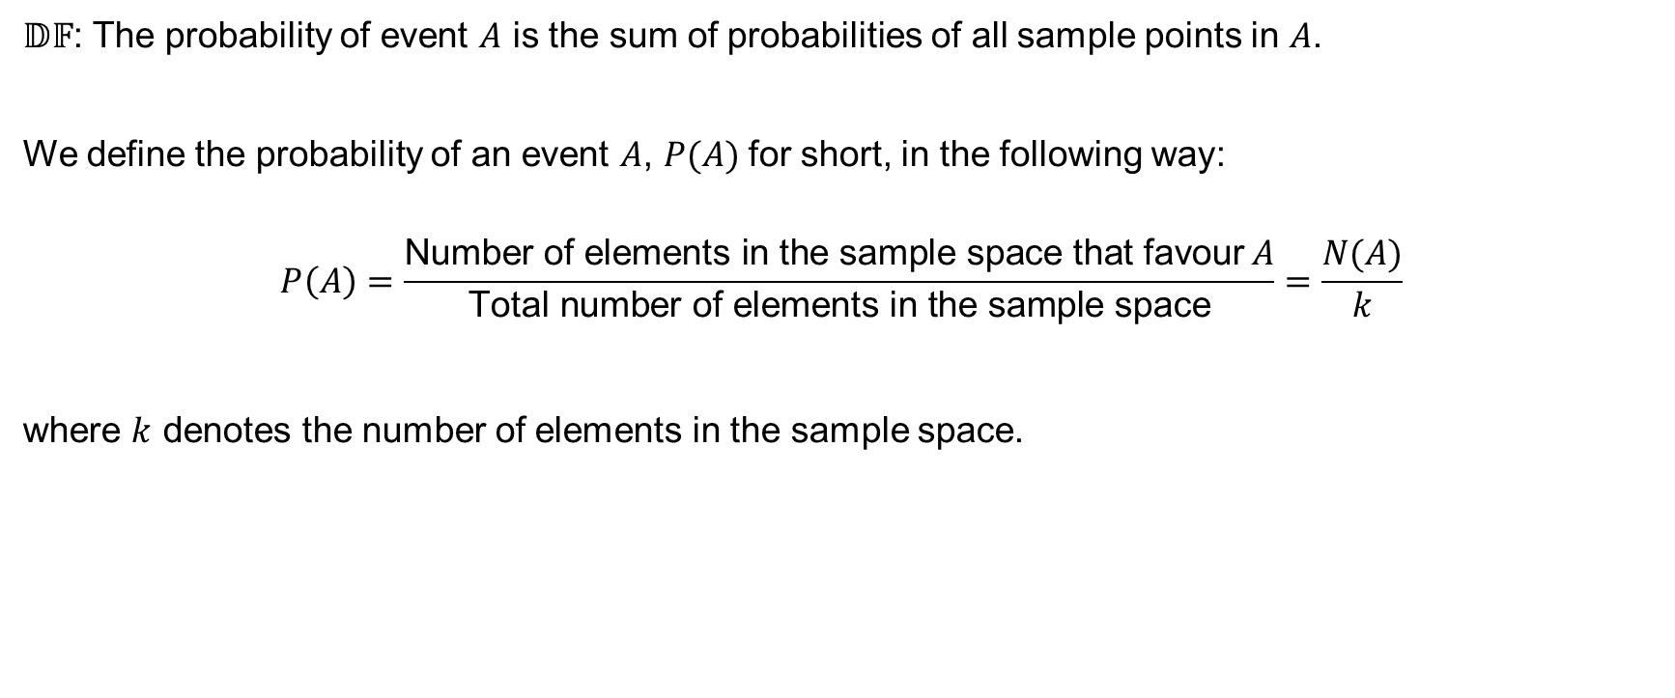
Probability of events
$𝔻𝔽$: The probability of event $A$ is the sum of probabilities of all sample points in $A$.
We define the probability of an event $A$, $P(A)$for short, in the following way:
$$P\left(A\right)=\frac{\text{Number} \text{of} \text{elements} \text{in} \text{the} \text{sample} \text{space} \text{that} \text{favour} A}{\text{Total} \text{number} \text{of} \text{elements} \text{in} \text{the} \text{sample} \text{space}}=\frac{N(A)}{k}$$
where $k$ denotes the number of elements in the sample space.

Slide 20
Example 5.2
Consider the example of a well shuffled pack of cards. What is the probability that if we cut the pack, the card we obtain is a red king?

Slide 21
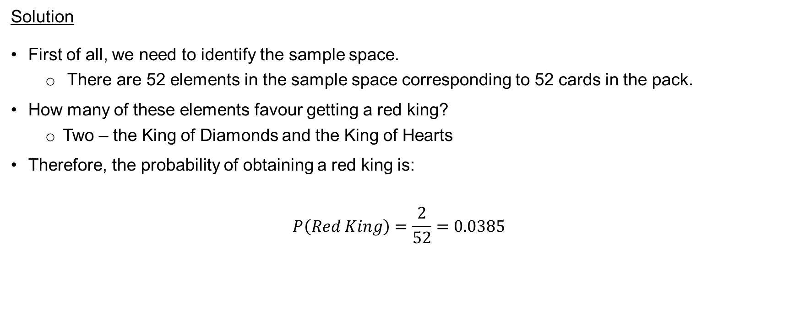
Example 5.2 (continued)
Solution
First of all, we need to identify the sample space.
  There are 52 elements in the sample space corresponding to 52 cards in the pack.
How many of these elements favour getting a red king?
  Two – the King of Diamonds and the King of Hearts
Therefore, the probability of obtaining a red king is:
$$P\left(Red King\right)=\frac{2}{52}=0.0385$$

Slide 22
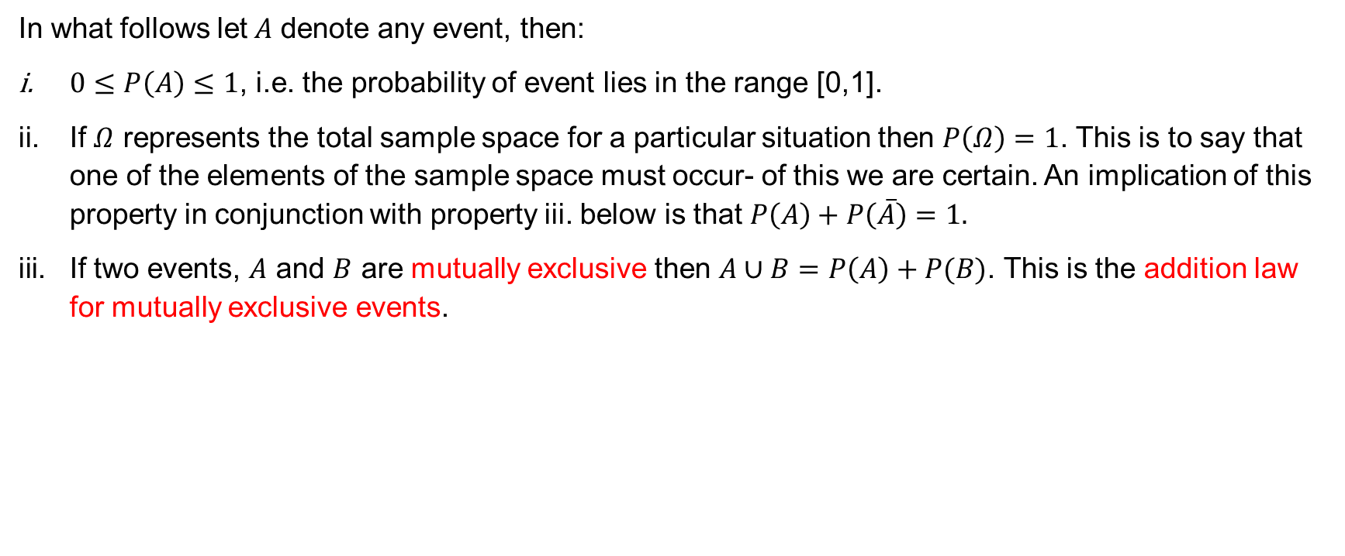
Elementary properties of probabilities
In what follows let$A$ denote any event, then:
$0≤P\left(A\right)≤1$, i.e. the probability of event lies in the range [0,1].
If $Ω$ represents the total sample space for a particular situation then $P\left(Ω\right)=1$. This is to say that one of the elements of the sample space must occur- of this we are certain. An implication of this property in conjunction with property iii. below is that $P\left(A\right)+P\left(\overline{A}\right)=1.$
If two events, $A$ and $B$ are mutually exclusive then $A∪B=P\left(A\right)+P(B)$. This is the addition law for mutually exclusive events.

Slide 23
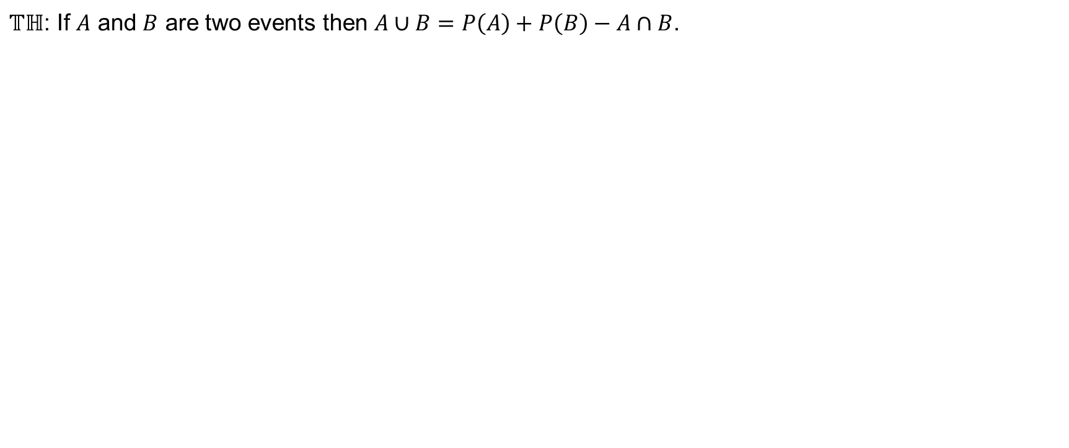
The Addition Law for non-mutually exclusive events
$𝕋ℍ$: If $A$ and $B$ are two events then $A∪B=P\left(A\right)+P\left(B\right)−A∩B$.

Slide 24
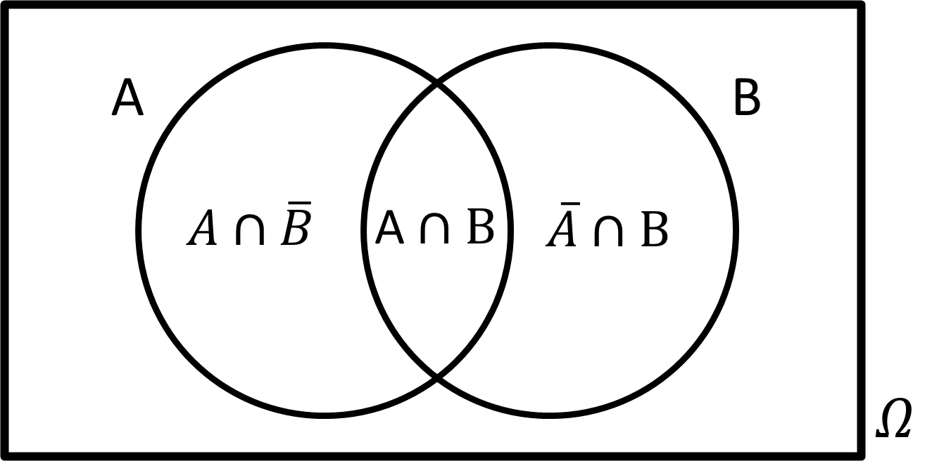
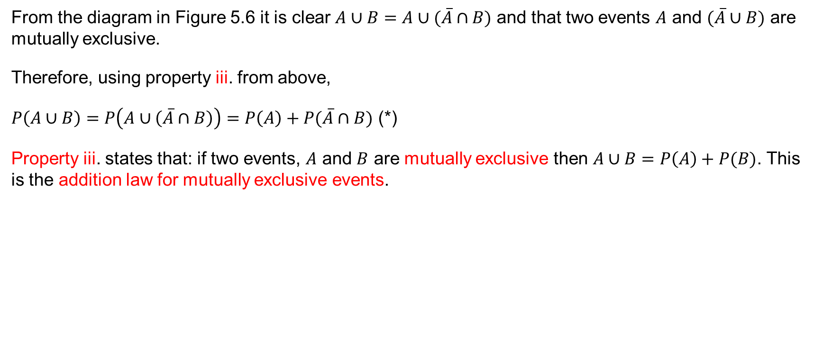
Proof
From the diagram in Figure 5.6 it is clear $A∪B=A∪(\overline{A}∩B)$ and that two events $A$ and $(\overline{A}∪B)$ are mutually exclusive.
Therefore, using property iii. from above,
$P\left(A∪B\right)=P\left(A∪\left(\overline{A}∩B\right)\right)=P\left(A\right)+P(\overline{A}∩B)$ (*)
Property iii. states that: if two events, $A$ and $B$ are mutually exclusive then $A∪B=P\left(A\right)+P(B)$. This is the addition law for mutually exclusive events.

Slide 25
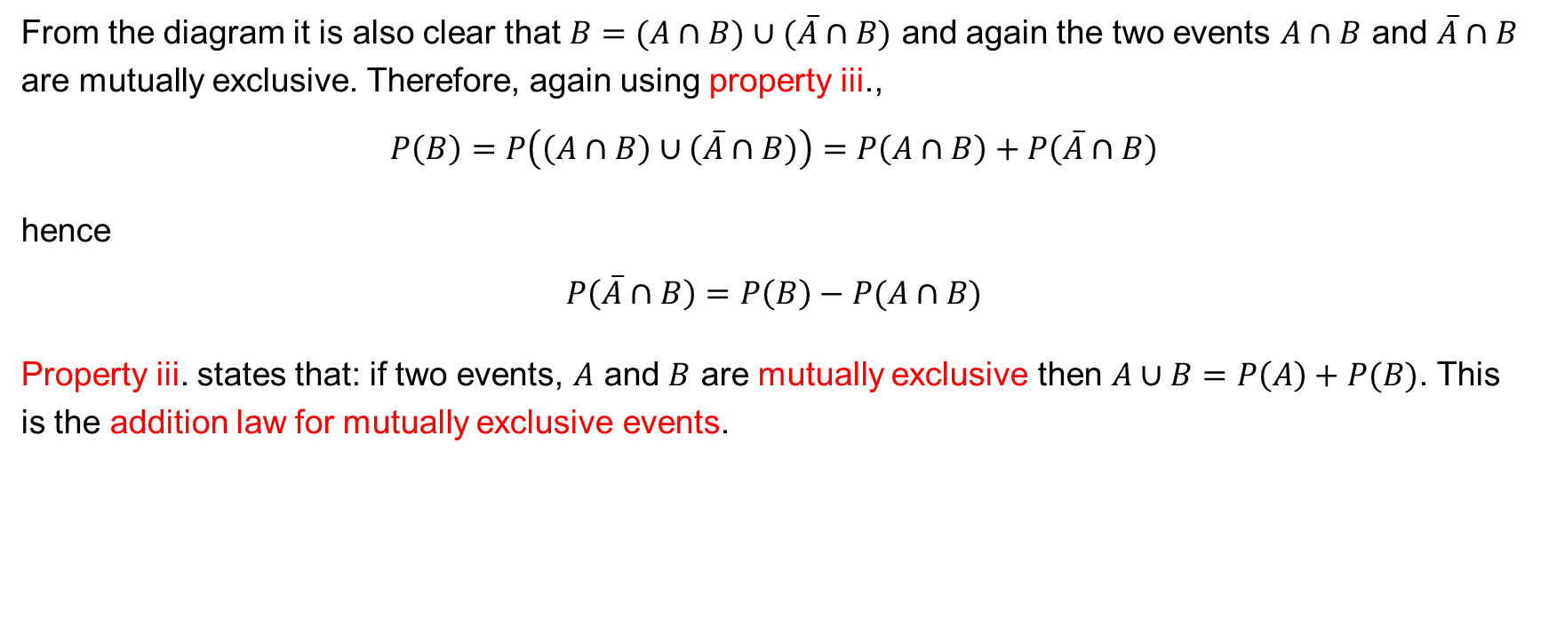
Proof (continued)
From the diagram it is also clear that $B=(A∩B)∪(\overline{A}∩B)$ and again the two events $A∩B$ and $\overline{A}∩B$ are mutually exclusive. Therefore, again using property iii.,
$$P\left(B\right)=P\left(\left(A∩B\right)∪\left(\overline{A}∩B\right)\right)=P\left(A∩B\right)+P\left(\overline{A}∩B\right)$$
hence
$$P\left(\overline{A}∩B\right)=P\left(B\right)−P(A∩B)$$
Property iii. states that: if two events, $A$ and $B$ are mutually exclusive then $A∪B=P\left(A\right)+P(B)$. This is the addition law for mutually exclusive events.

Slide 26
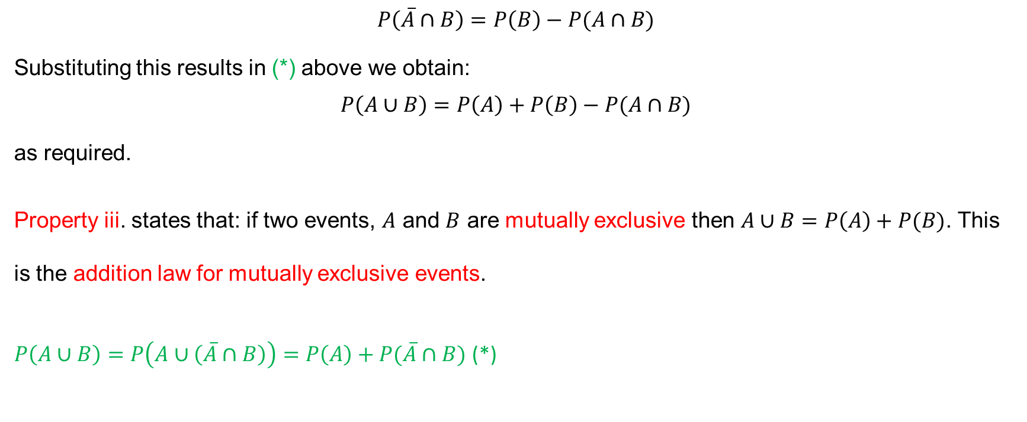
Proof (continued)
$$P\left(\overline{A}∩B\right)=P\left(B\right)−P(A∩B)$$
Substituting this results in (*) above we obtain:
$$P\left(A∪B\right)=P\left(A\right)+P\left(B\right)−P(A∩B)$$
as required.
Property iii. states that: if two events, $A$ and $B$ are mutually exclusive then $A∪B=P\left(A\right)+P(B)$. This is the addition law for mutually exclusive events.
$P\left(A∪B\right)=P\left(A∪\left(\overline{A}∩B\right)\right)=P\left(A\right)+P(\overline{A}∩B)$ (*)

Slide 27
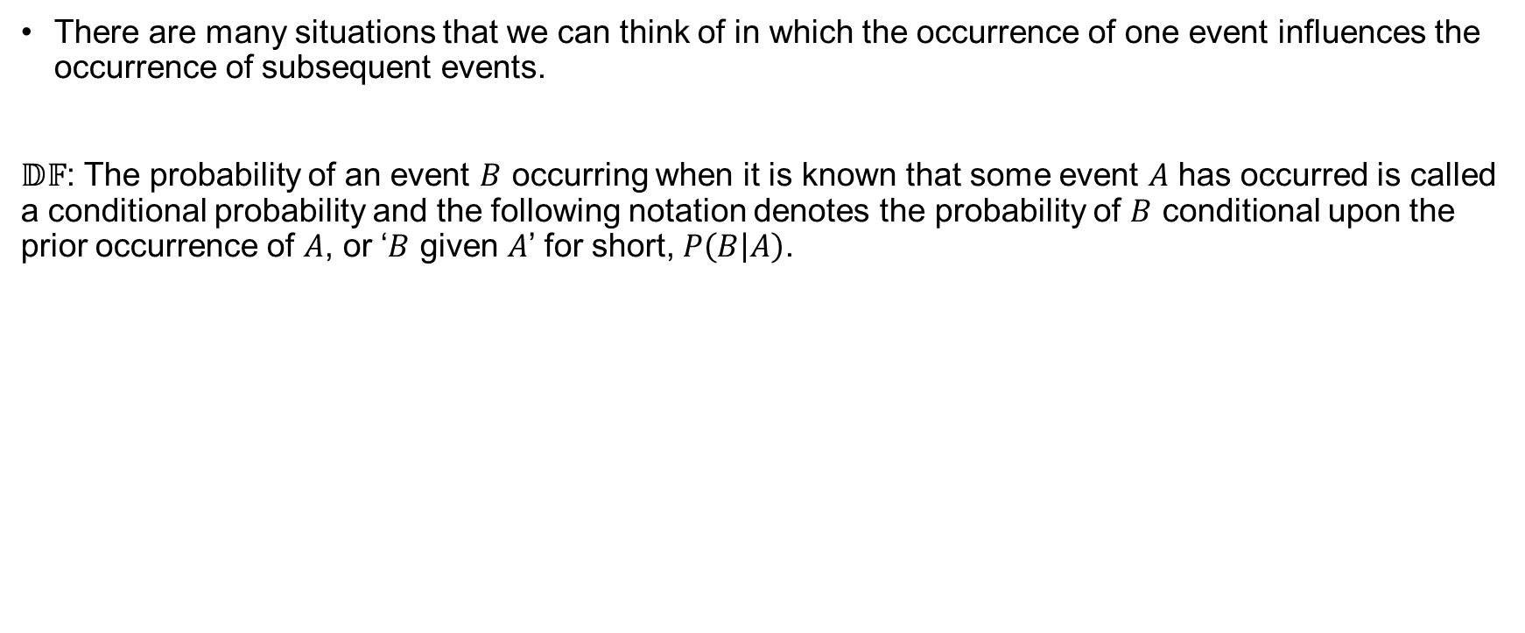
Conditional Probability
There are many situations that we can think of in which the occurrence of one event influences the occurrence of subsequent events.
$𝔻𝔽$: The probability of an event $B$ occurring when it is known that some event $A$ has occurred is called a conditional probability and the following notation denotes the probability of $B$ conditional upon the prior occurrence of $A$, or ‘$B$ given $A$’ for short, $P\left(B | A\right)$.

Slide 28
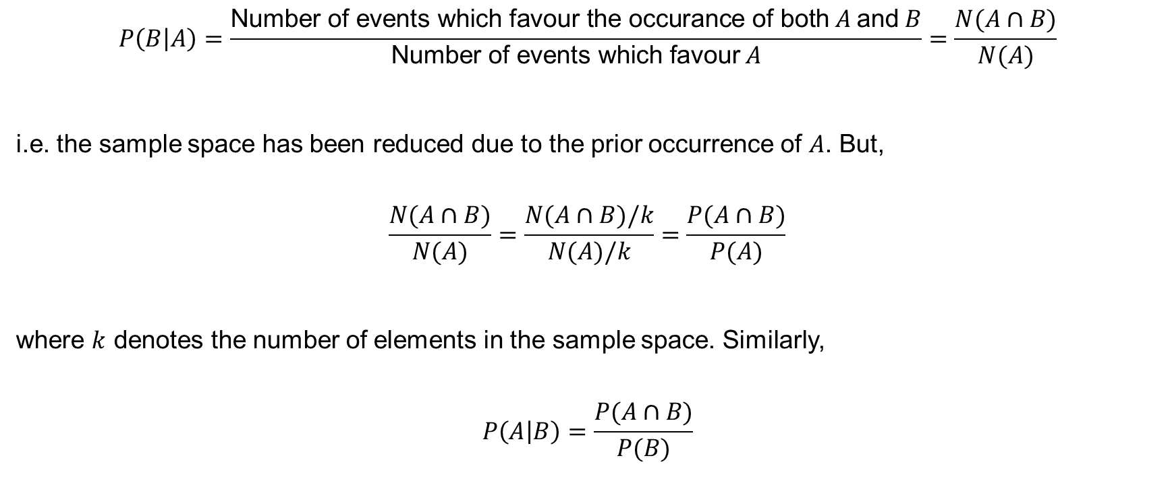
Conditional Probability (continued)
$$P\left(B | A\right)=\frac{\text{Number} \text{of} \text{events} \text{whi}\text{c}\text{h} \text{favour} \text{the} \text{occurance} \text{of} \text{both} A \text{and} B}{\text{Number} \text{of} \text{events} \text{which} \text{favour} A}=\frac{N(A∩B)}{N(A)}$$
i.e. the sample space has been reduced due to the prior occurrence of $A$. But,
$$\frac{N(A∩B)}{N(A)}=\frac{N(A∩B)/k}{N(A)/k}=\frac{P(A∩B)}{P(A)}$$
where $k$ denotes the number of elements in the sample space. Similarly,
$$P\left(A | B\right)=\frac{P(A∩B)}{P(B)}$$

Slide 29
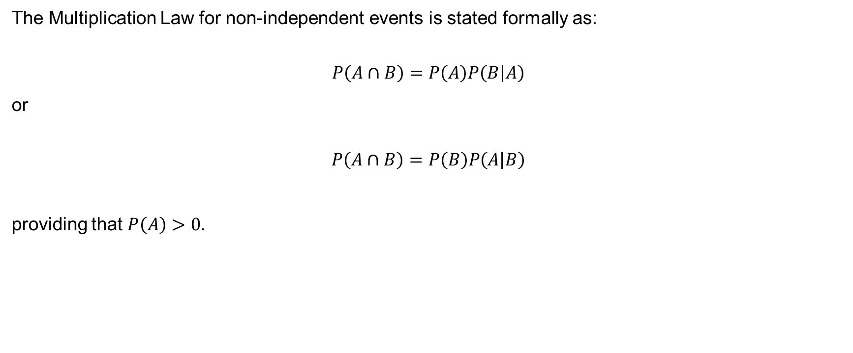
Multiplication Law
The Multiplication Law for non-independent events is stated formally as:
$$P\left(A∩B\right)=P\left(A\right)P\left(B | A\right)$$
or
$$P\left(A∩B\right)=P\left(B\right)P\left(A | B\right)$$
providing that $P\left(A\right)>0$.

Slide 30
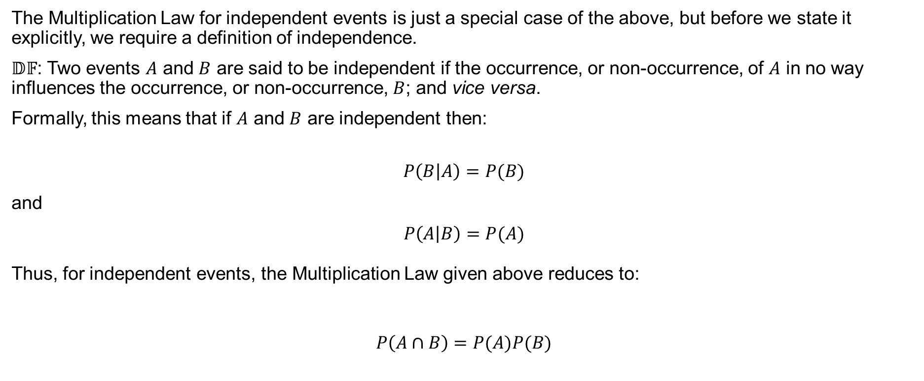
Multiplication Law (continued)
The Multiplication Law for independent events is just a special case of the above, but before we state it explicitly, we require a definition of independence.
$𝔻𝔽$: Two events $A$ and $B$ are said to be independent if the occurrence, or non-occurrence, of $A$ in no way influences the occurrence, or non-occurrence, $B$; and vice versa.
Formally, this means that if $A$ and $B$ are independent then:
$$P\left(B | A\right)=P(B)$$
and
$$P\left(A | B\right)=P(A)$$
Thus, for independent events, the Multiplication Law given above reduces to:
$$P\left(A∩B\right)=P(A)P(B)$$

Slide 31
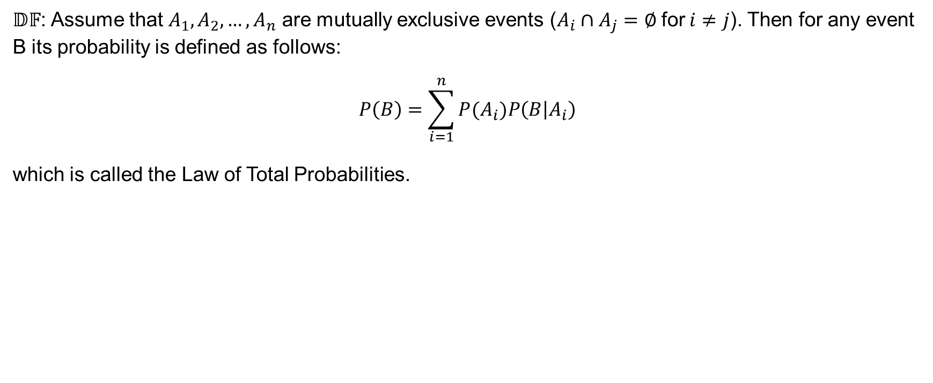
Law of total probabilities
$𝔻𝔽$: Assume that $A_{1},A_{2},…,A_{n}$ are mutually exclusive events ($A_{i}∩A_{j}=∅ \text{for} i≠j$). Then for any event B its probability is defined as follows:
$$P\left(B\right)=\sum_{i=1}^{n}{P(A_{i})P\left(B | A_{i}\right)}$$
which is called the Law of Total Probabilities.

Slide 32
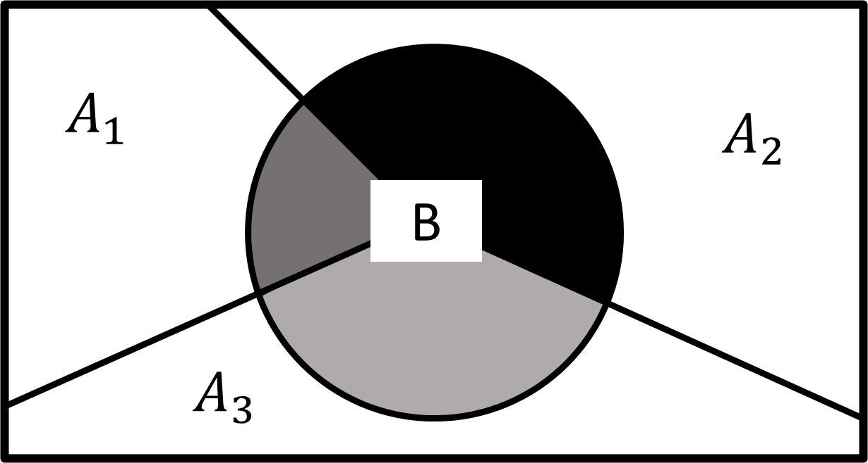
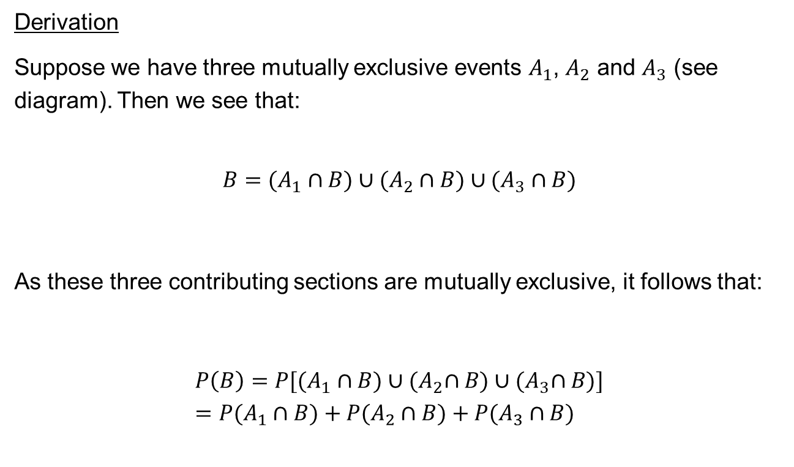
Bayes’ Theorem
Derivation
Suppose we have three mutually exclusive events $A_{1}$, $A_{2}$ and $A_{3}$ (see diagram). Then we see that:
$$B=(A_{1}∩B)∪(A_{2}∩B)∪(A_{3}∩B)$$
As these three contributing sections are mutually exclusive, it follows that:
$$P\left(B\right)=P[(A_{1}∩B)∪{(A}_{2}∩B)∪{(A}_{3}∩B)]=P(A_{1}∩B)+P(A_{2}∩B)+P(A_{3}∩B)$$

Slide 33
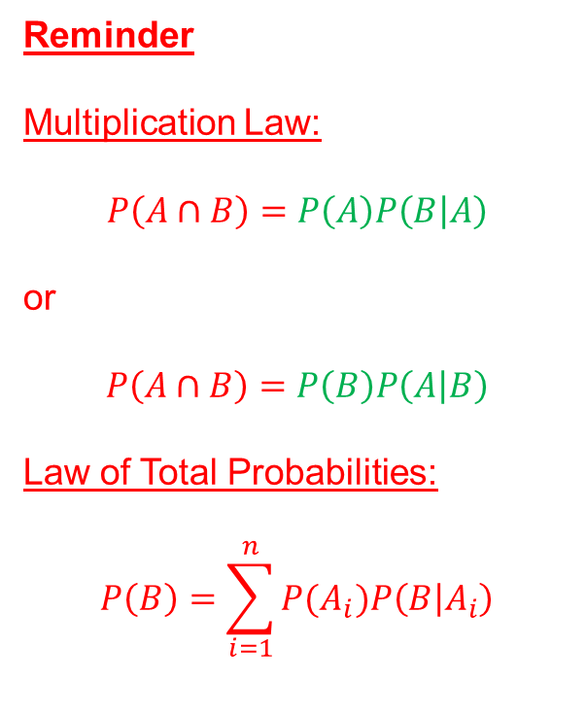
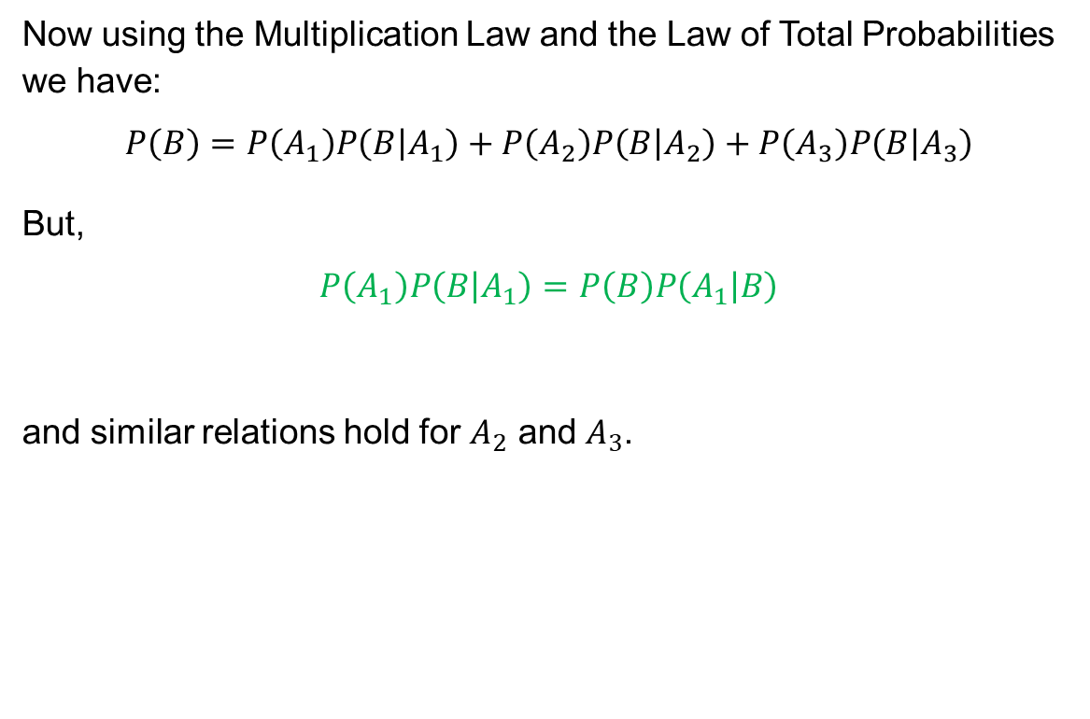
Derivation (continued)
Now using the Multiplication Law and the Law of Total Probabilities we have:
$$P\left(B\right)=P\left(A_{1}\right)P\left(B | A_{1}\right)+P\left(A_{2}\right)P\left(B | A_{2}\right)+P\left(A_{3}\right)P\left(B | A_{3}\right)$$
But,
$$P\left(A_{1}\right)P\left(B | A_{1}\right)=P\left(B\right)P\left(A_{1} | B\right)$$
and similar relations hold for $A_{2}$ and $A_{3}$.
Reminder
Multiplication Law:
$$P\left(A∩B\right)=P\left(A\right)P\left(B | A\right)$$
or
$$P\left(A∩B\right)=P\left(B\right)P\left(A | B\right)$$
Law of Total Probabilities:
$$P\left(B\right)=\sum_{i=1}^{n}{P(A_{i})P\left(B | A_{i}\right)}$$

Slide 34
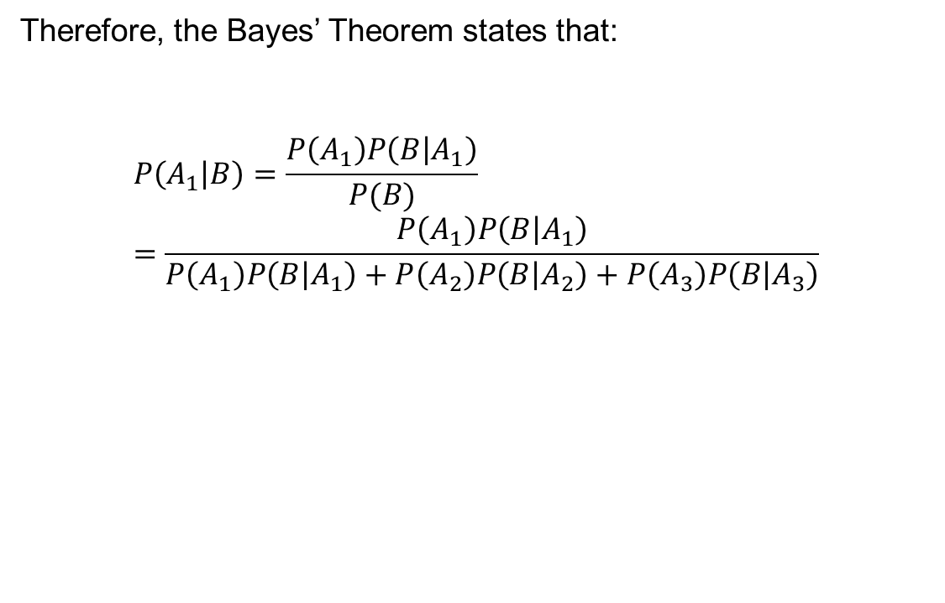
Derivation (continued)
Therefore, the Bayes’ Theorem states that:
$$P\left(A_{1} | B\right)=\frac{P\left(A_{1}\right)P\left(B | A_{1}\right)}{P(B)}=\frac{P\left(A_{1}\right)P\left(B | A_{1}\right)}{P\left(A_{1}\right)P\left(B | A_{1}\right)+P\left(A_{2}\right)P\left(B | A_{2}\right)+P\left(A_{3}\right)P\left(B | A_{3}\right)}$$
Reminder
Multiplication Law:
$$P\left(A∩B\right)=P\left(A\right)P\left(B | A\right)$$
or
$$P\left(A∩B\right)=P\left(B\right)P\left(A | B\right)$$
Law of Total Probabilities:
$$P\left(B\right)=\sum_{i=1}^{n}{P(A_{i})P\left(B | A_{i}\right)}$$

Slide 35
Example 5.3
A bag contains 10 beads; 5 white, 3 red and 2 green. Two beads are drawn, without replacement, from the bag. Find the probability that:
2 whites,
2 of the same colour,
2 different colours are drawn.

Slide 36
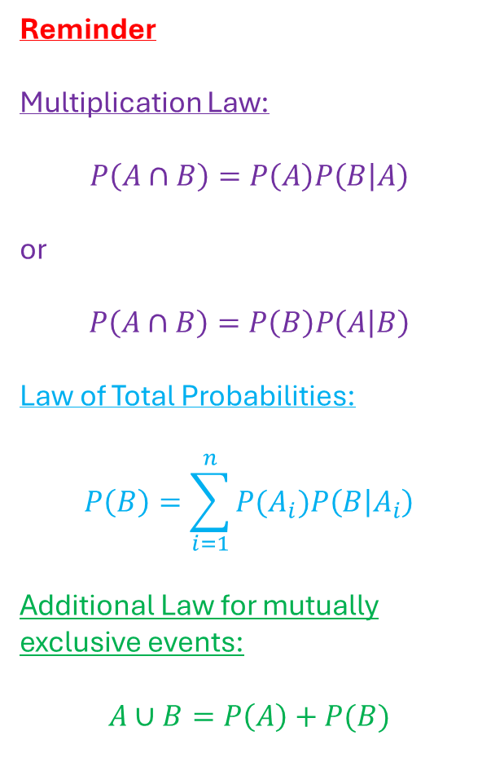
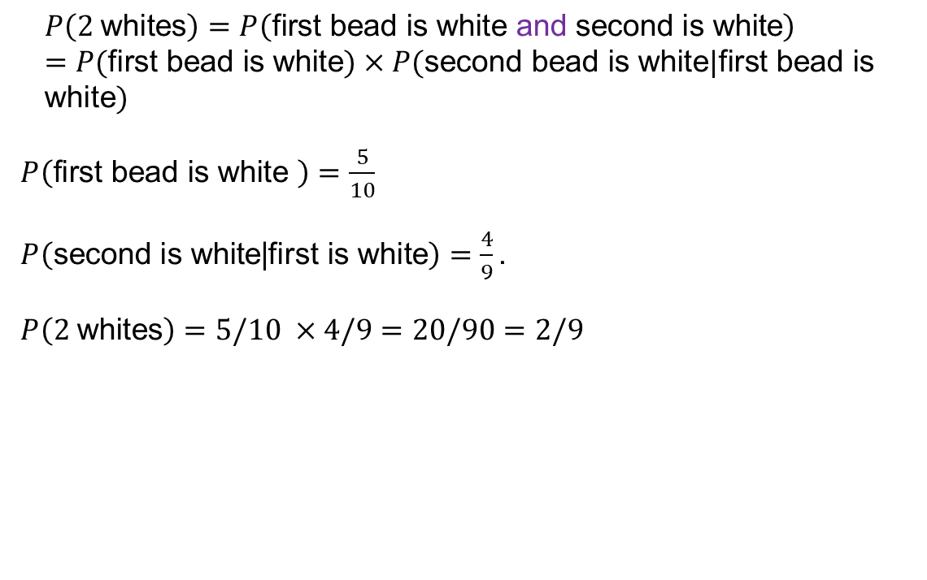
Solution to i.
Reminder
Multiplication Law:
$$P\left(A∩B\right)=P\left(A\right)P\left(B | A\right)$$
or
$$P\left(A∩B\right)=P\left(B\right)P\left(A | B\right)$$
Law of Total Probabilities:
$$P\left(B\right)=\sum_{i=1}^{n}{P(A_{i})P\left(B | A_{i}\right)}$$
Additional Law for mutually exclusive events:
$$A∪B=P\left(A\right)+P(B)$$
$$P\left(2 \text{whites}\right)=P\left(\text{first} \text{bead} \text{is} \text{white} \text{and} \text{second} \text{is} \text{white}\right)=P(\text{first} \text{bead} \text{is} \text{white})×P(\text{second} \text{bead} \text{is} \text{white}|\text{first} \text{bead} \text{is} \text{white})$$
$P\left(\text{first} \text{bead} \text{is} \text{white} \right)=\frac{5}{10}$
$P\left(\text{second} \text{is} \text{white}\text{|}\text{first} \text{is} \text{white}\right)=\frac{4}{9}\text{.}$
$P\left(2 \text{whit}\text{e}\text{s}\right)=5/10 ×4/9=20/90=2/9$

Slide 37
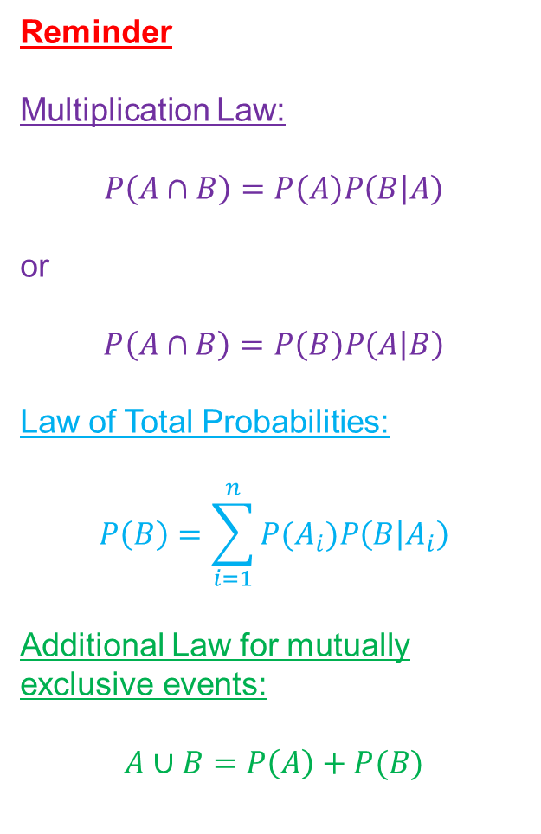
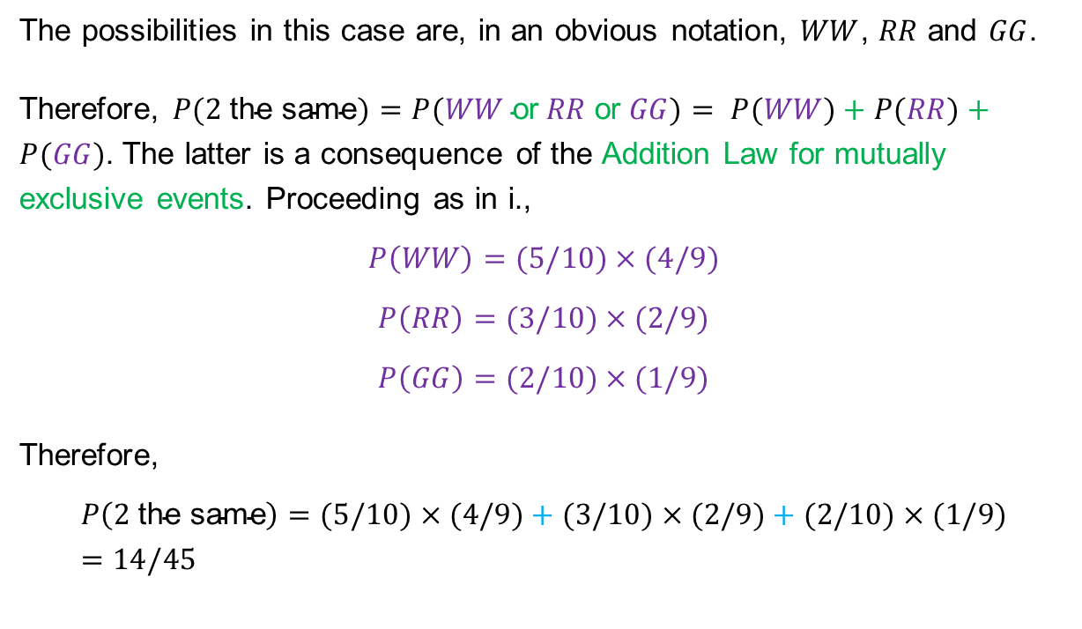
Solution to ii.
Reminder
Multiplication Law:
$$P\left(A∩B\right)=P\left(A\right)P\left(B | A\right)$$
or
$$P\left(A∩B\right)=P\left(B\right)P\left(A | B\right)$$
Law of Total Probabilities:
$$P\left(B\right)=\sum_{i=1}^{n}{P(A_{i})P\left(B | A_{i}\right)}$$
Additional Law for mutually exclusive events:
$$A∪B=P\left(A\right)+P(B)$$
The possibilities in this case are, in an obvious notation, $WW$, $RR$ and $GG$.
Therefore, $P(2 \text{the} \text{same})=P(WW \text{or} RR \text{or} GG)= P(WW)+P(RR)+P(GG)$. The latter is a consequence of the Addition Law for mutually exclusive events. Proceeding as in i.,
$$P\left(WW\right)=(5/10)×(4/9)$$
$$P\left(RR\right)=(3/10)×(2/9)$$
$$P\left(GG\right)=(2/10)×(1/9)$$
Therefore,
$$P\left(2 \text{the} \text{same}\right)=(5/10)×(4/9)+(3/10)×(2/9)+(2/10)×(1/9)=14/45$$

Slide 38
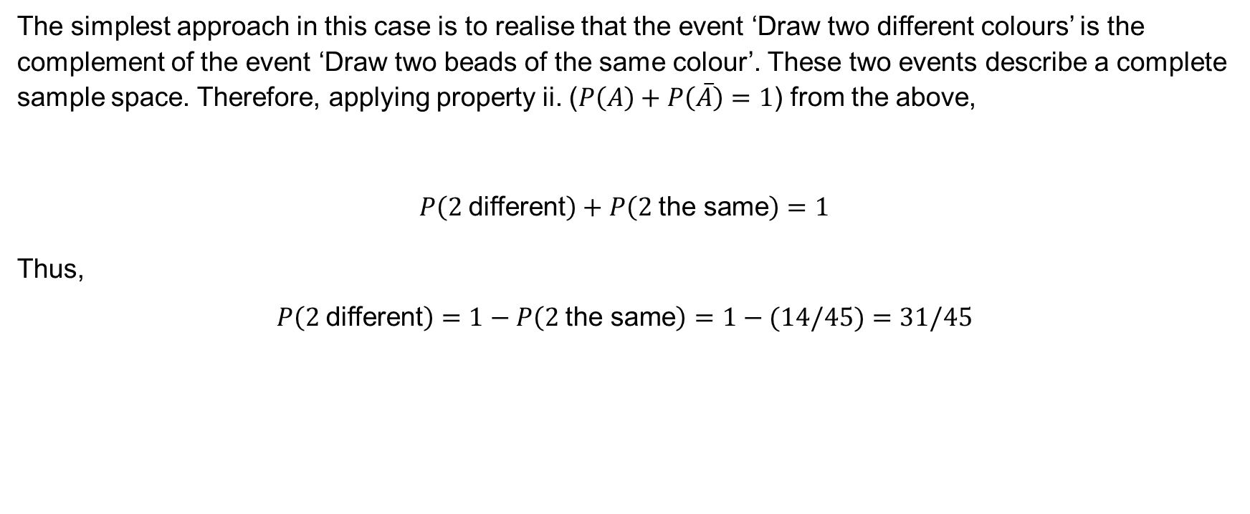
Solution to iii.
The simplest approach in this case is to realise that the event ‘Draw two different colours’ is the complement of the event ‘Draw two beads of the same colour’. These two events describe a complete sample space. Therefore, applying property ii. ($P\left(A\right)+P\left(\overline{A}\right)=1$) from the above,
$$P\left(2 \text{different}\right)+P\left(2 \text{the} \text{same}\right)=1$$
Thus,
$$P\left(2 \text{different}\right)=1−P\left(2 \text{the} \text{same}\right)=1−(14/45)=31/45$$

Slide 39
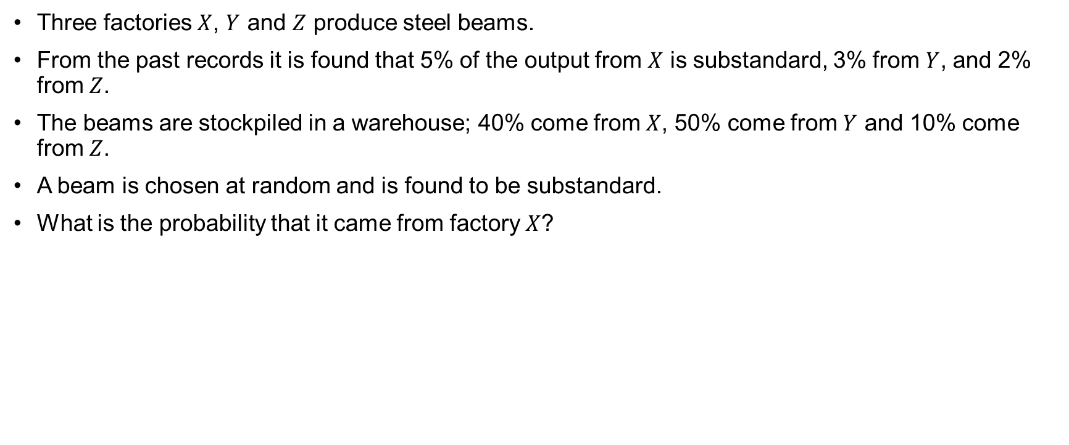
Example 5.4
Three factories $X$, $Y$ and $Z$ produce steel beams.
From the past records it is found that 5% of the output from $X$ is substandard, 3% from $Y$, and 2% from $Z$.
The beams are stockpiled in a warehouse; 40% come from $X$, 50% come from $Y$ and 10% come from $Z$.
A beam is chosen at random and is found to be substandard.
What is the probability that it came from factory $X$?

Slide 40
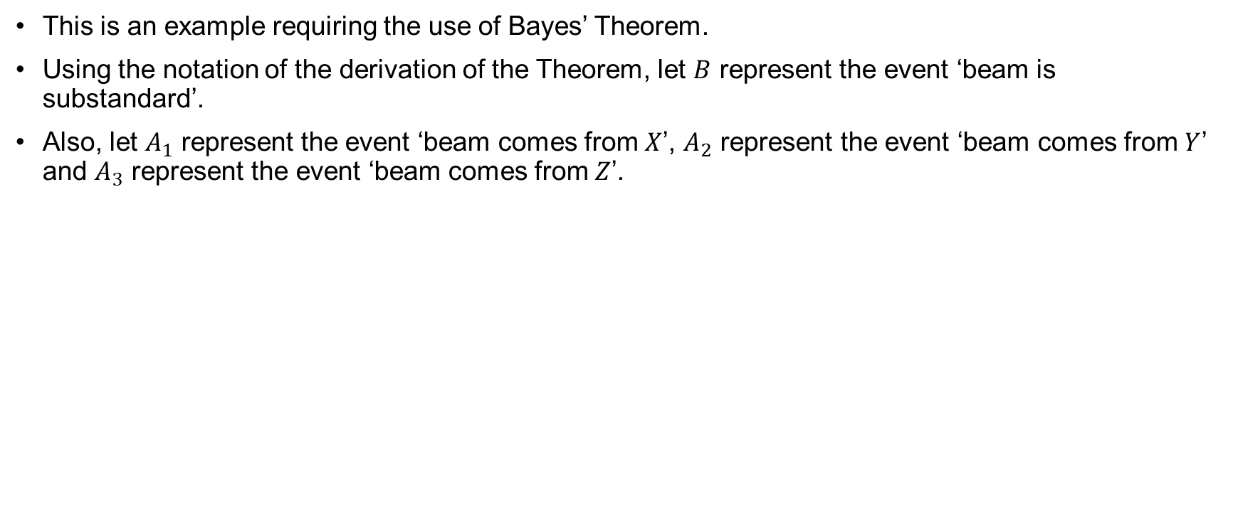
Solution
This is an example requiring the use of Bayes’ Theorem.
Using the notation of the derivation of the Theorem, let $B$ represent the event ‘beam is substandard’.
Also, let $A_{1}$ represent the event ‘beam comes from $X$’, $A_{2}$ represent the event ‘beam comes from $Y$’ and $A_{3}$ represent the event ‘beam comes from $Z$’.

Slide 41
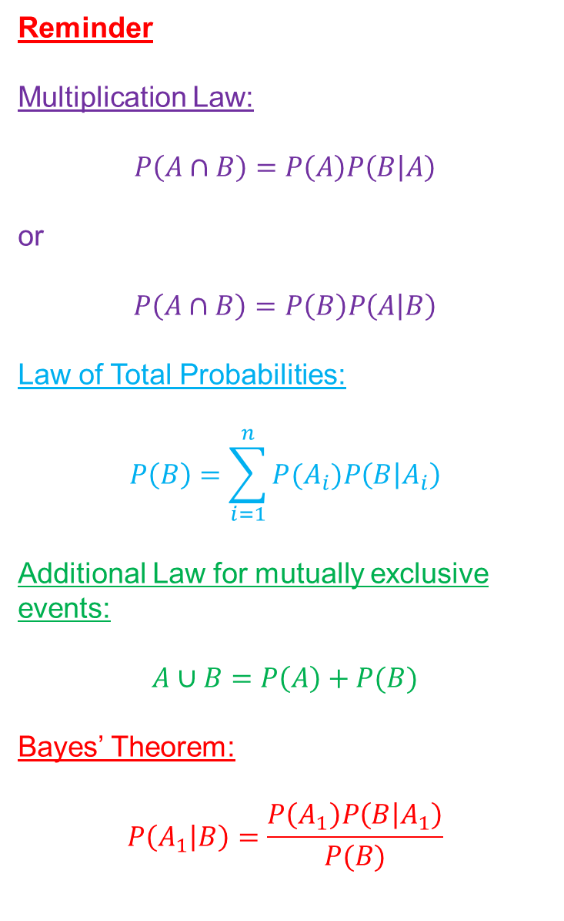
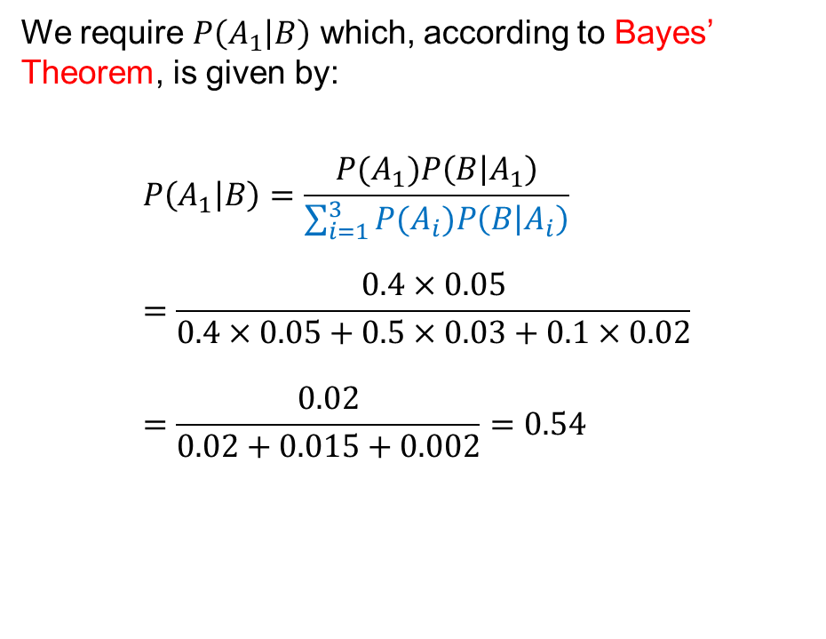
Solution (continued)
Reminder
Multiplication Law:
$$P\left(A∩B\right)=P\left(A\right)P\left(B | A\right)$$
or
$$P\left(A∩B\right)=P\left(B\right)P\left(A | B\right)$$
Law of Total Probabilities:
$$P\left(B\right)=\sum_{i=1}^{n}{P(A_{i})P\left(B | A_{i}\right)}$$
Additional Law for mutually exclusive events:
$$A∪B=P\left(A\right)+P(B)$$
Bayes’ Theorem:
$$P\left(A_{1} | B\right)=\frac{P\left(A_{1}\right)P\left(B | A_{1}\right)}{P(B)}$$
We require $P\left(A_{1} | B\right)$ which, according to Bayes’ Theorem, is given by:
$$P\left(A_{1} | B\right)=\frac{P(A_{1})P\left(B | A_{1}\right)}{\sum_{i=1}^{3}{{P(A}_{i})P\left(B | A_{i}\right)}}=\frac{0.4×0.05}{0.4×0.05+0.5×0.03+0.1×0.02}=\frac{0.02}{0.02+0.015+0.002}=0.54$$

